Slide 1

Capstone Project
Play Store App Review Analysis
By
Chetan Chaudhari
Data Science Trainee, AlmaBetter

Slide 2






WHY ANALYZE THE GOOGLE PLAY STORE?
Mobile App Market is set to grow 20% by 2023
Android Apps comprise 90% of the Mobile App Market
What makes an App popular? Can we predict how popular it’s going to be?
What are some interesting patterns in user behavior related to app usage & feedback?

Slide 3

Introduction
Android is the most popular operating system in the world, with over 2.5 billion active users spanning over 190 countries.
Google Play was launched on March 6, 2012, bringing together Android Market marking a shift in Google's digital distribution strategy .
Android is the dominant mobile operating system today more than 85% of all
mobile devices running Google’s OS. The Google Play Store is the largest and most
popular Android app store.
There are more than 3.04 million apps found on Google Play Store.
The Play Store apps data has enormous potential to drive app-making businesses
to success.
Actionable insights can be drawn for developers to work on and capture the
Android market.
The purpose of our project is to gather and analyze detailed information on apps in the Google Play Store in order to provide insights on app features and the current state of the Android app market.

Slide 4
Problem Statement
Problem Statement
In this project i have given 2 data sets one with basic information and the other with user reviews.
I have to examine and evaluate the data in both datasets in order to identify the important characteristics that inﬂuence the app engagement and success.
So, what factors inﬂuence an app's success?
An app is said to be successful if it has:
A high average user rating
A good number of positive reviews
A good number of monthly average users
High revenue per customer and so on.

Slide 5
Dataset Preparation
Import Libraries: NumPy, Pandas, Seaborn and Matplotlib
Loading the data sets: Two datasets, First Play store app
dataset and User Reviews dataset.
Data cleaning: Null values, Finding and removing Outliers, Removing special charters and alphabet.
Data Manipulation: Filling the missing categorical values with mode and numerical values with median. Conversion of price, installs, reviews into numerical values.
Exploratory Data Analysis: Analyzing the data sets to summarize their main characteristics using statistical graphics and data visualizations method.

Slide 6
1.App : This column Contains the name of the app for each observation. 2.Category : This column Contains Category to which the app belongs. 3.Rating : This column contains the average rating for the app. 4.Reviews : This column contains the number of reviews that the app has received on the play store. 5.Size : This column contains the amount of memory the app occupies on the device. 6.Installs : This column contains the number of times that the app has been downloaded and installed from the play store. 7.Type : This column contains the information whether the app is free or paid. 8.Price: If the app is a paid app, this column contains the data about its price. 9.Content Rating: This column contains the maturity rating of the app i.e. the age group of the audience for which it is suitable. 10.Genres: This column contains the data about to which genre the app belongs. Genres can be considered as a further division of the group of Category. 11.Last Updated: Contains the date on which the latest update of the app was released. 12.Current Version: Contains information on the current version of the app available on the play store. 13.Android Version: Contains information about the android versions on which the app is supported.
Attributes in Google Play store Data

Slide 7
Attributes in User reviews
App- Application name
Translated Review- User review
Sentiment- Positive/Negative/Neutral
Sentiment Polarity- Sentiment polarity score
Sentiment Subjectivity- Sentiment subjectivity score

Slide 8



OVERVIEW OF ANALYSIS
Data Exploration
Data Cleaning
Predictive Modeling
Uncover initial patterns, characteristics, and points of interest using visual exploration
Understand the structure of the dataset and clean data before analysis
Formulate a statistical model to forecast an outcome using relevant predictors

Slide 9

EDA Begins

Slide 10
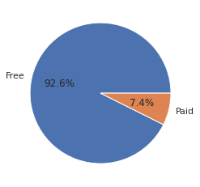
Percentage of Paid apps v/s Free apps
.

Slide 11
As we can see from the upper pie chart is that free applications consist of a major portion of Google Play store. Paid applications are significantly less as compared to free applications. We can also conclude that developers are most dependent on post-business instead of pre-business. (Free Apps = 92.6% , Paid Apps = 7.4%)

Slide 12
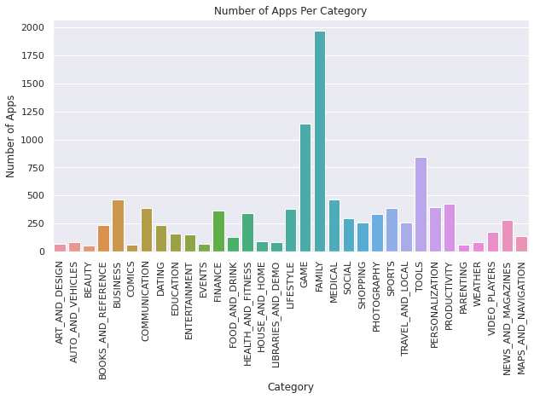
Number of Apps per category

Slide 13
From the above plotting we observe that most of the apps in the play store are from the categories of 'Family', 'Game' and also 'Tools.
We can conclude that playstore is flooded with Family and Gaming apps.

Slide 14
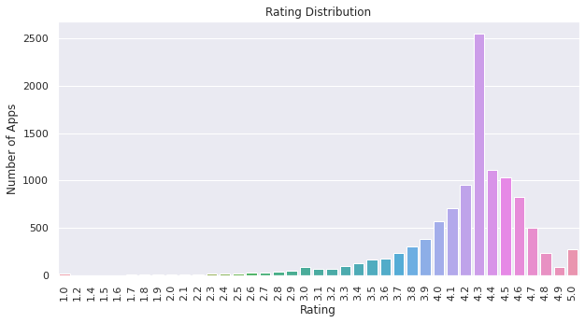
Rating Distribution

Slide 15
From this distribution plotting, it implies that most of the apps in the Play Store are having rating higher than 4 or in the range of 4 to 4.7. We conclude that the median of the rating is 4.3.
The majority of the apps in the Play Store (~80%) are top rated.
This implies that the majority of the users are happy with the services received via the respective app.

Slide 16
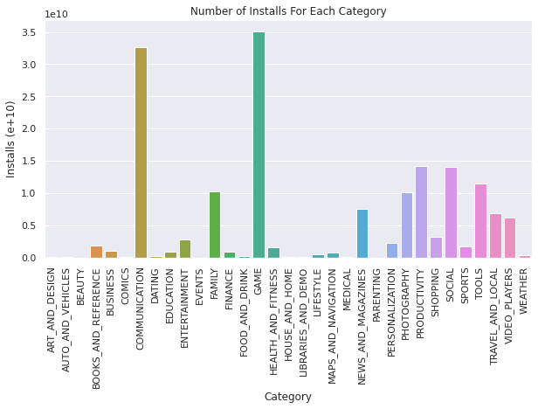
Number of Installs for each category

Slide 17
As per the above bar diagram we conclude that most of the apps being downloaded and installed are from the categories of 'Game' and 'Communication’.
Though playstore consists of ‘Family’ apps, but users installed 'Game' and 'Communication’ apps more so we say that young population who uses google playstore is more as compare to other.

Slide 18
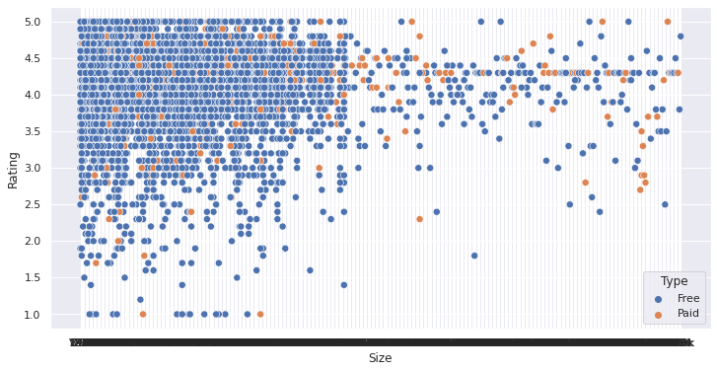
Distribution of apps in term of their rating, size and type

Slide 19
As per the above scatter plot, we can imply that majority of the free apps are small in size and having high rating. While for paid apps, we have quite equal distribution in term on size and rating.

Slide 20
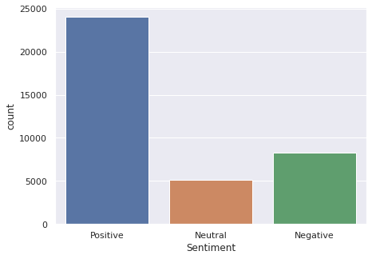
Count vs Sentiments

Slide 21
As we can see from the graph people with positive sentiments tend to give more feedback as compared to neutral and negative sentiments. Positive sentiments indicating user satisfaction with the product provided by the developer or the administrator.
While negative sentiment indicates user dissatisfaction.

Slide 22
Questions and Answers
Which are the 5 apps having the lowest review and Installs?
2. Which are the bottom 3 installed apps in Game category?
The bottom 3 installed apps in the GAME category are: YAKALA AY, Mu.F.O., Ra Ga Ba
3. Which of the top 5 apps from the 'FAMILY' category are having the highest rating?
:
The 5 apps having the lowest review and Installs are: CX Network, Pekalongan CJ, Ain Arabic Kids Alif Ba ta,
AP Series Solution Pro, cronometra-br
The top 5 apps from the FAMILY category are having the highest rating are Fr. Mike Schmitz Audio Teachings,
CT Brain Interpretation, BK Video Status, EP Radio, Exam Result BD
4. What are the top 5 expensive apps?
The top 5 most expensive apps in the store are: I'm Rich - Trump Edition,
I am rich, I am Rich!, most expensive app (H), I am Rich
5. What are the top 5 reviewed apps?
The 5 apps that have the most number of total reviews are: Instagram, WhatsApp Messenger,
Messenger – Text and Video Chat for Free, Subway Surfers, Facebook

Slide 23
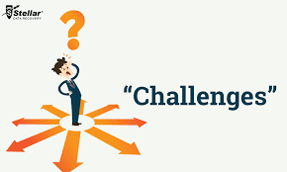
Challenges Faced
Reading the dataset and comprehending the problem statement.
Handling the error, duplicate and NaN values in the dataset.
Designing multiple visualizations to summarize the information in the dataset and successfully communicate the results and trends to the reader.

Slide 24
Conclusion’s
Play Store is flooded with Apps that are mostly
free to use. (More than 92% apps)
Family, Game and Tools are top three categories (1906, 926 and 829 app count respectively).
Category with the highest number of installs: Game
The median Rating of app is 4.3 while mean is 4.2. Hence the data
is “ Skewed to the left ”.
The reviews on apps are more of positive sentiment as compare to negative sentiment. So, we say that users are satisfied with what they got on google play store.

Slide 25


